Slide 1
Polynomial Regression

Slide 2
Learning Goals
In this section, we will cover:
- Extending linear regression
- Using polynomial features to capture nonlinear effects
- Other models that can be used for regression and classification

Slide 3
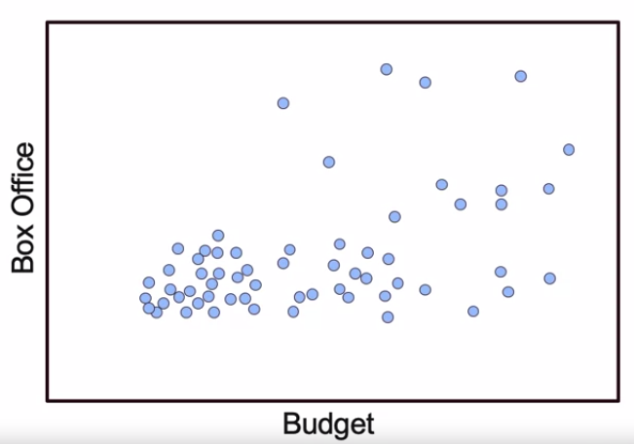
Addition of Polynomial Features
Capture higher order features of data by adding polynomial features.

Slide 4
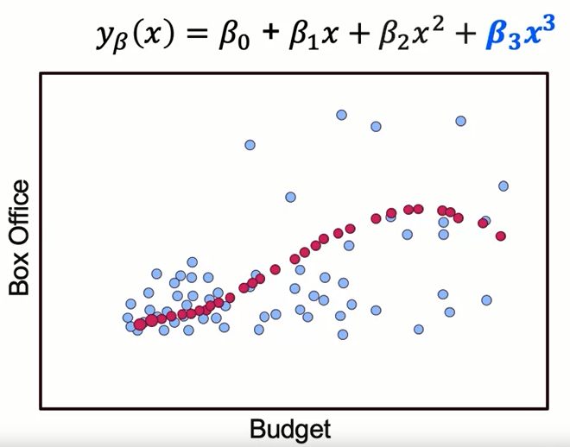
Addition of Polynomial Features
Capture higher order features of data by adding polynomial features.
"Linear regression" means linear combinations of features

Slide 5
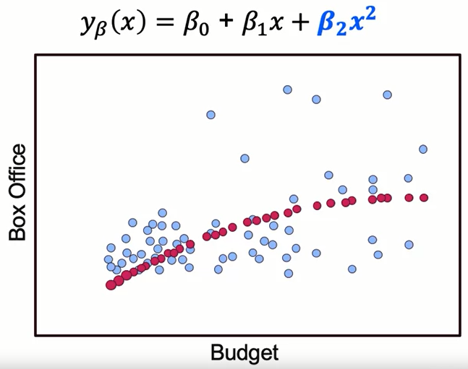
Addition of Polynomial Features
Capture higher order features of data by adding polynomial features.

Slide 6
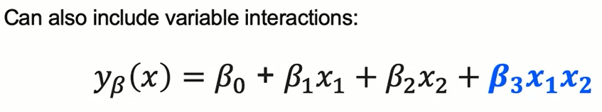
Addition of Polynomial Features
How is the correct functional form chosen?
- Check relationship of each variable or with outcome.

Slide 7
Enhancing the Linear Model
Adjusting the standard linear approach to regression by adding polynomial features is one of many approaches to dealing with the fundamental problems:
- prediction
- interpretation
As we move into model evaluation, keep in mind that the same tools are useful for evaluating a wide variety of regression and classification problems.

Slide 8
Enhancing the Linear Model
Prediction:
Model performance is estimated in terms of its accuracy to predict the occurrence of an event on unseen data. A more accurate model is seen as a more valuable model.
Interpretation:
Model interpretability provides insight into the relationship between in the inputs and the output. An interpreted model can answer questions as to why the independent features predict the dependent attribute.
The predictive models that are most powerful are usually the least interpretable.

Slide 9
Extending the Linear Model
In addition to Polynomial features, we will also examine several additional variants of standard models, using many for both regression and classification.
Some examples include:
Logistic Regression
K-Nearest Neighbors
Decision Trees
Support Vector Machines
Random Forests
Ensemble Methods
Deep Learning Approaches

Slide 10
Extending the Linear Model
Logistic Regression: This type of statistical model (also known as logit model) is often used for classification and predictive analytics. Logistic regression estimates the probability of an event occurring, such as voted or didn’t vote, based on a given dataset of independent variables.
K-Nearest Neighbors: also known as KNN or k-NN, is a non-parametric, supervised learning classifier, which uses proximity to make classifications or predictions about the grouping of an individual data point. While it can be used for either regression or classification problems, it is typically used as a classification algorithm, working off the assumption that similar points can be found near one another.

Slide 11
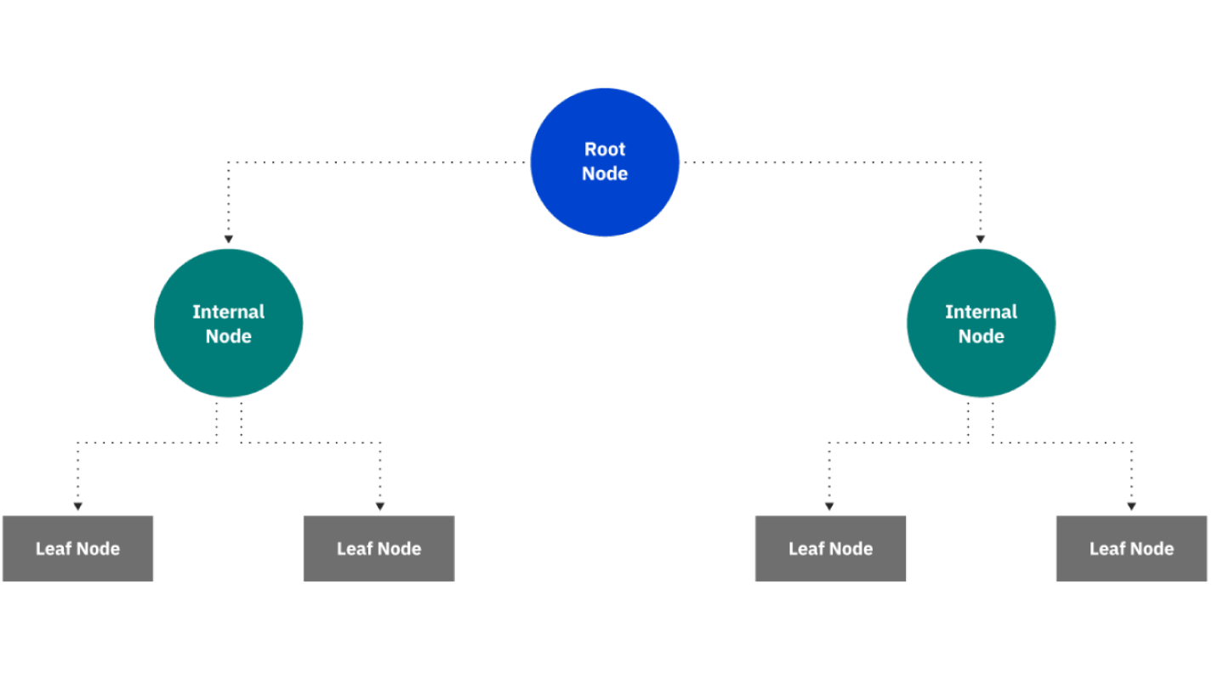
Extending the Linear Model
Decision Trees: a non-parametric supervised learning algorithm, which is utilized for both classification and regression tasks. It has a hierarchical, tree structure, which consists of a root node, branches, internal nodes and leaf nodes.

Slide 12
Extending the Linear Model
Support Vector Machines:
A robust classification and regression technique that maximizes the predictive accuracy of a model without overfitting the training data. SVM is particularly suited to analyzing data with very large numbers (for example, thousands) of predictor fields.
SVM has applications in many disciplines, including customer relationship management (CRM), facial and other image recognition, bioinformatics, text mining concept extraction, intrusion detection, protein structure prediction, and voice and speech recognition.
Random Forests: a commonly-used machine learning algorithm trademarked by Leo Breiman and Adele Cutler, which combines the output of multiple decision trees to reach a single result. Its ease of use and flexibility have fueled its adoption, as it handles both classification and regression problems.

Slide 13
Extending the Linear Model
Ensemble Methods: combine the predictions of several base estimators built with a given learning algorithm in order to improve generalizability / robustness over a single estimator
Deep Learning Approaches: a subset of machine learning, which is essentially a neural network with three or more layers. These neural networks attempt to simulate the behavior of the human brain—albeit far from matching its ability—allowing it to “learn” from large amounts of data. While a neural network with a single layer can still make approximate predictions, additional hidden layers can help to optimize and refine for accuracy.

Slide 14
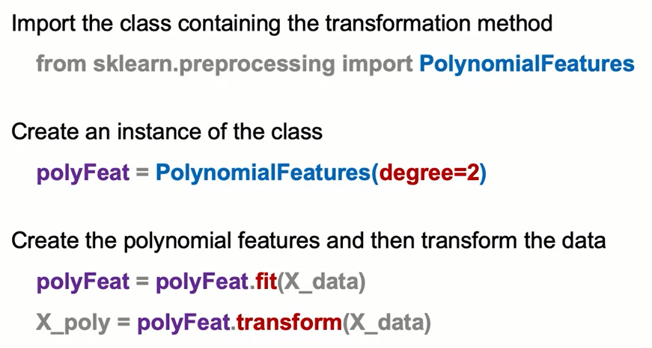
Polynomial Features: The Syntax

Slide 15
Summary
Polynomial Regression
Polynomial terms help you capture nonlinear effects of your features.
Other algorithms that help you extend your linear models are:
Logistic Regression
K-Nearest Neighbors
Decision Trees
Support Vector Machines
Random Forests
Ensemble Methods
Deep Learning Approaches

Slide 16
Learning Recap
In this section, we discussed:
- Extending linear regression
- Using polynomial features to capture nonlinear effects
- Other models that can be used for regression and classification

